Slide 1


SypoL add chemicals Guide v1.0
v03.26
For additional Support in GEV contact Ross Conway (ross.conway@gevernova.com)

Slide 2
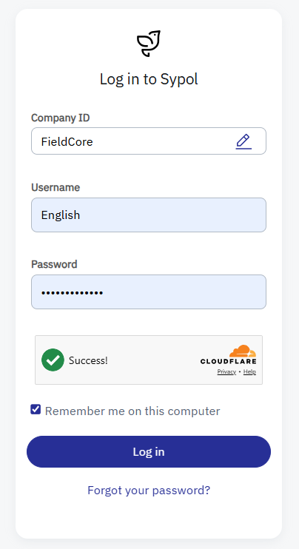
Login to: Sypol CMS (cms.sypol.com/ )
1:
Tip: (remember to include the “!” after ….123)
Password: Chemicals123!

Slide 3
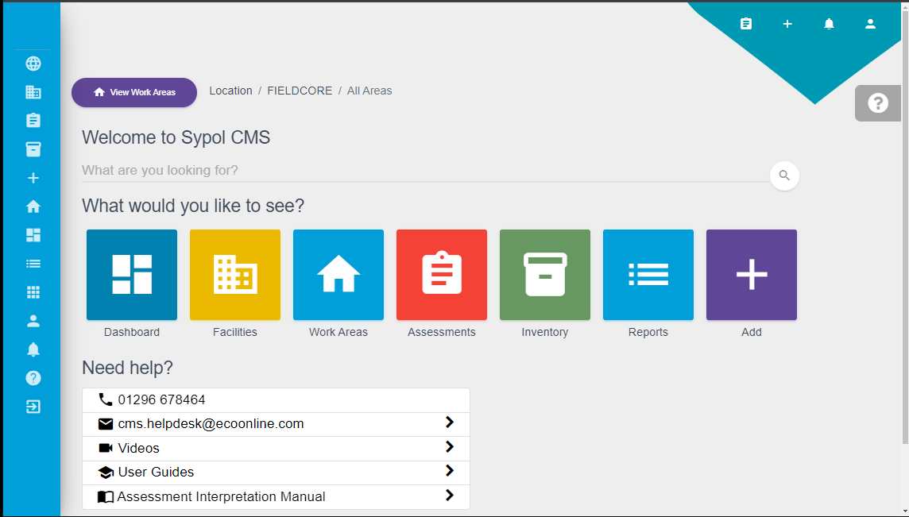
Add a new assessment (+)
1:

Slide 4
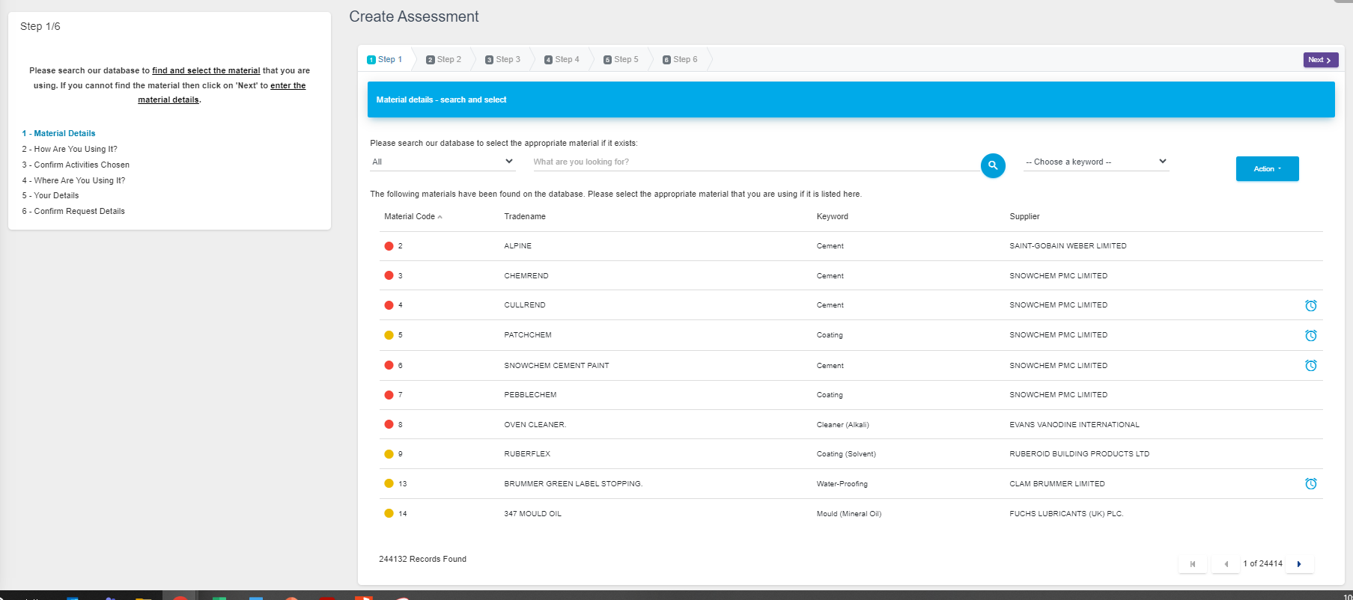
First Screen (ignore if you have an SDS already
(Click Next in Top right-hand side)
1: This can be used if you have no SDS
2:

Slide 5
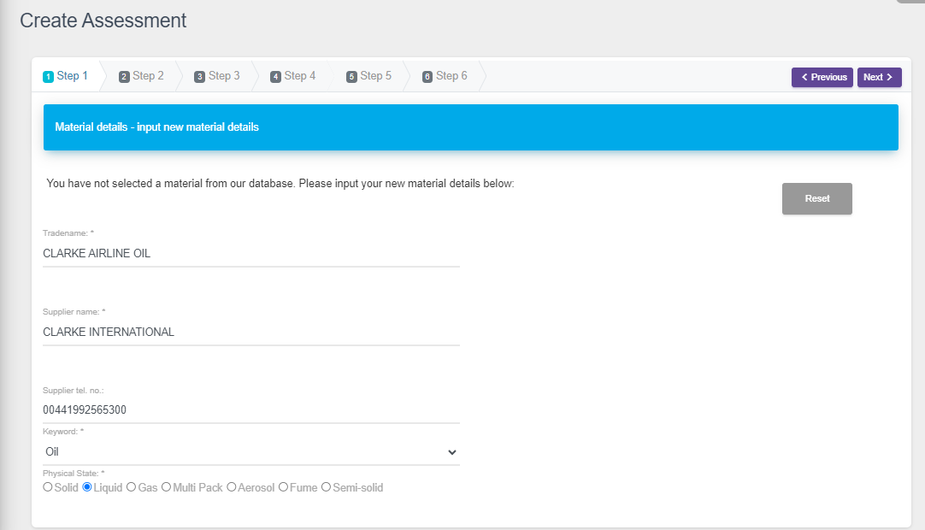
Example: CLARKE AIRLINE OIL
2:
1: Fill in details from SDS

Slide 6
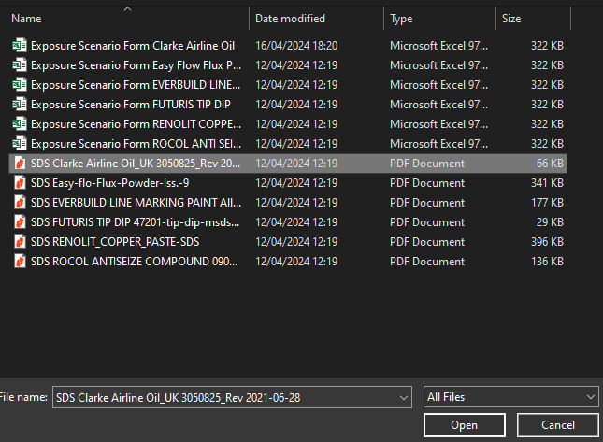
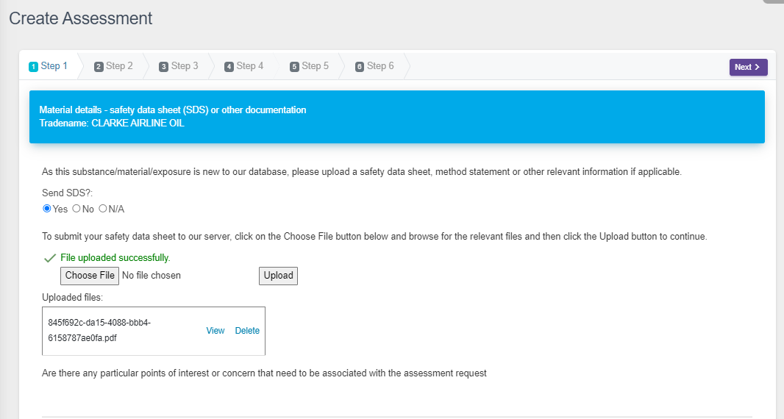
Attach the SDS (downloaded to you laptop)
5:
3:
1:
2:
4:

Slide 7
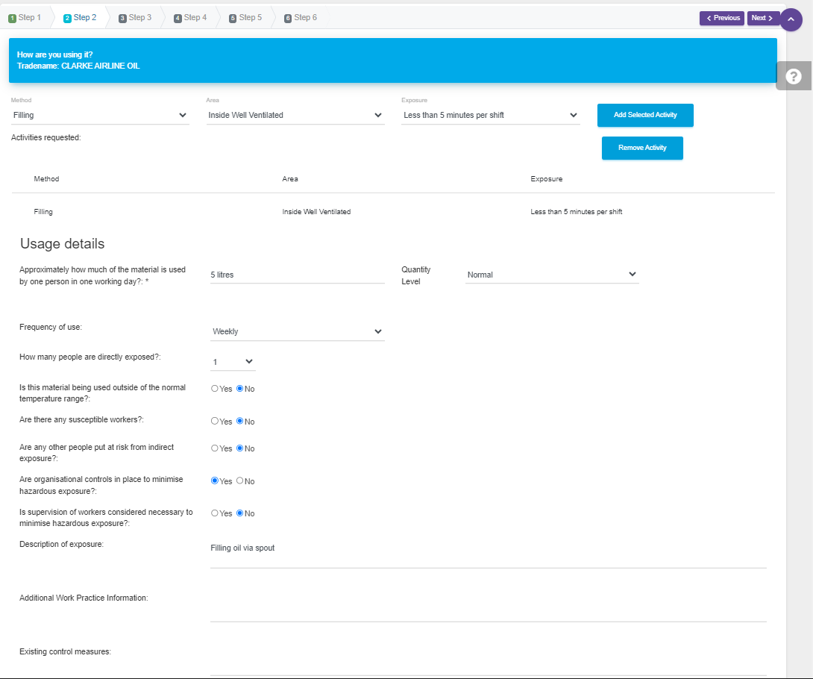
Fill in how you are using it
5:
1:
2:
3: Fill in for the typical amount used g/kg ml/L etc, how often and my how many people
5:
these
Are the
typical
answers
4: Add a short description of task
5: Add details if relevant

Slide 8
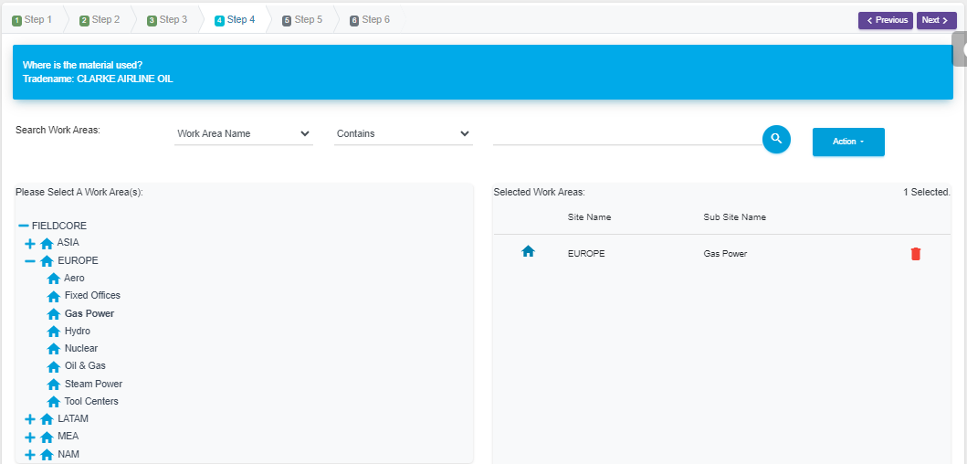
Assign to a work area (be specific to service line)
: 3
1:
2:

Slide 9
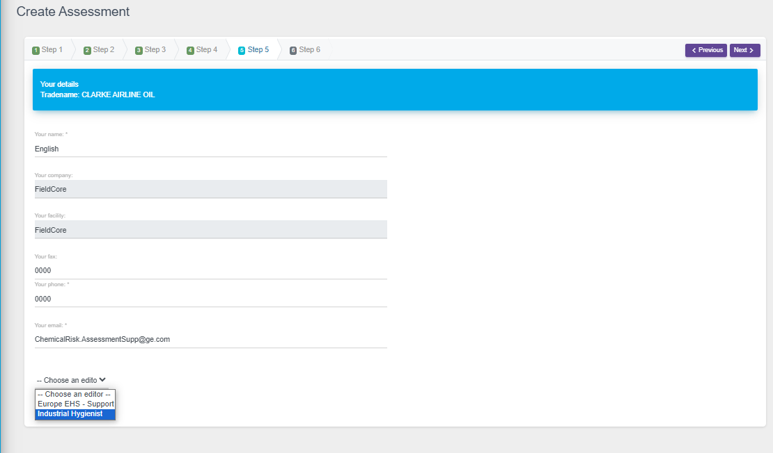
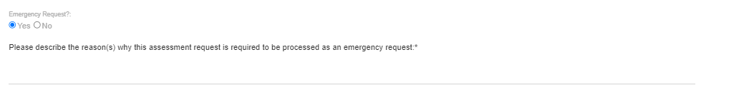
Add you details
: 4
1:
2: Auto-fills
Ignore (write 0000)
Ignore (write 0000)
add your email, you will get notified, when assessment is ready, (or if Sypol Team have any queries)
4: If you need a CRA - ASAP 24hrs Generation (normal take 5 days) Note we can only do this x2 a week (i.e. only use if really needed)
3: Select Europe EHS - IH
5 : Needed on site urgently

Slide 10
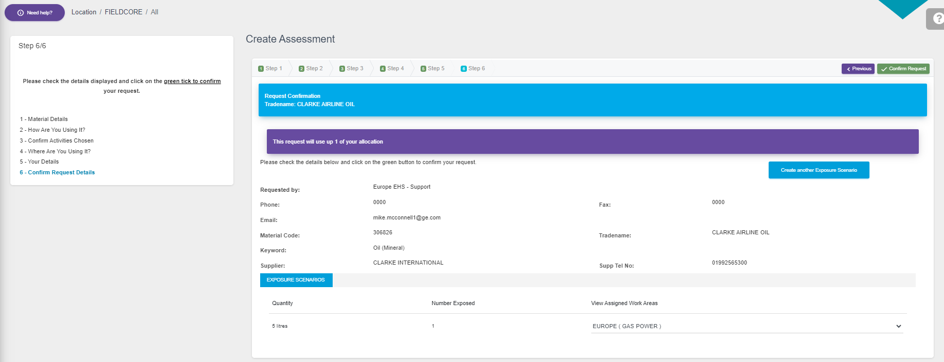
Final Stage: Confirm your request
1:
check email , you will get notified, when assessment is ready, (or if Sypol Team have any queries)
4: If you need a CRA - ASAP 24hrs Generation (normal take 5 days) Note we can only do this x2 a week (i.e. only use if really needed)

